Slide 1
Black Box Testing
Presented by
Krishna Jothi A

Slide 2
INTRODUCTION
A testing technique where the internal structure/code of the software is not known to the tester.
Tests are based on requirements and functionality.
Focus on Inputs and Outputs.
Used to validate if the system behaves as expected with different inputs.

Slide 3
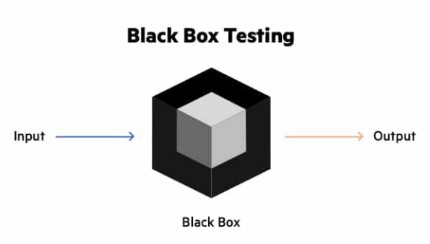
Architecture of Black Box Testing

Slide 4
Techniques Used in Black Box Testing
Equivalence Partitioning: Dividing input data into valid and invalid partitions.
Example: For a range input of 18-60, test values under 18, between 18-60, and above 60.
Boundary Value Analysis: Testing the boundaries between partitions. Test the extreme edges of input range.
Example: If the valid age range is 18-60, test 17, 18, 60, and 61.

Slide 5
Techniques Used in Black Box Testing
Decision Table Testing: Uses tables to define different input conditions and their corresponding actions.
Example: Testing different combinations of login attempts (valid/invalid username & password).
State Transition Testing: Test how the system reacts when it moves from one state to another.
Example: ATM – testing balance inquiry after entering the PIN correctly or incorrectly.

Slide 6
Techniques Used in Black Box Testing
Error Guessing: Error Guessing is when testers use their experience to guess where problems might happen.
Example: On a login page, a tester might leave the password blank to see if it causes an error.
Use Case Testing: Ensure the system behaves correctly when users perform specific actions to achieve a goal.
Example: In an online store, they check if a user can pick an item, add it to the cart, and pay for it.

Slide 7
Types of Black Box Testing
Functional Testing: Ensures that the software functions according to requirements.
Non-Functional Testing: Tests performance, usability, security, etc.
Regression Testing: Ensures new changes don’t affect existing functionality.

Slide 8
Advantages
Testers don't need to know programming or the system's internal design.
Suitable for functional and non-functional testing (performance, usability).
Tests how the user will experience the software.

Slide 9
Disadvantages
Limited coverage due to lack of internal code visibility.
Can't see the code, so can't find all bugs.
May test the same things more than once.
Difficult to identify the root cause of failures.

Slide 10
Conclusion
Black box testing is a useful way to make sure software works well for the user.
Use techniques like partitioning, boundary testing, and error guessing to find more issues.
Our job is to make sure that when we give certain inputs, the system provides the correct outputs according to the requirements.

Slide 11
THANK YOU

